Slide 1




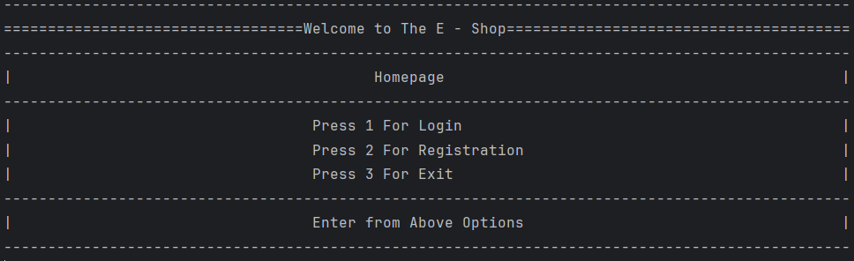
L.J. Institute of Engineering & Technology
Ecommerce Management System
By
Yash Parekh

Slide 2
Table of Contents
1
E - R Diagram
2
Use case Diagram
3
Used DATA Structures and Class
4
Used Concepts & Functionalities
5
Merits
6
Demerits
7
Future Enhancements
8
Used Tools

Slide 3
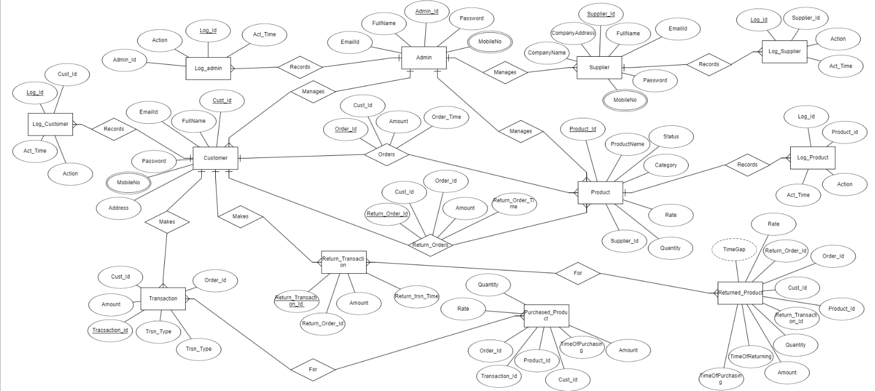
E R Diagram

Slide 4
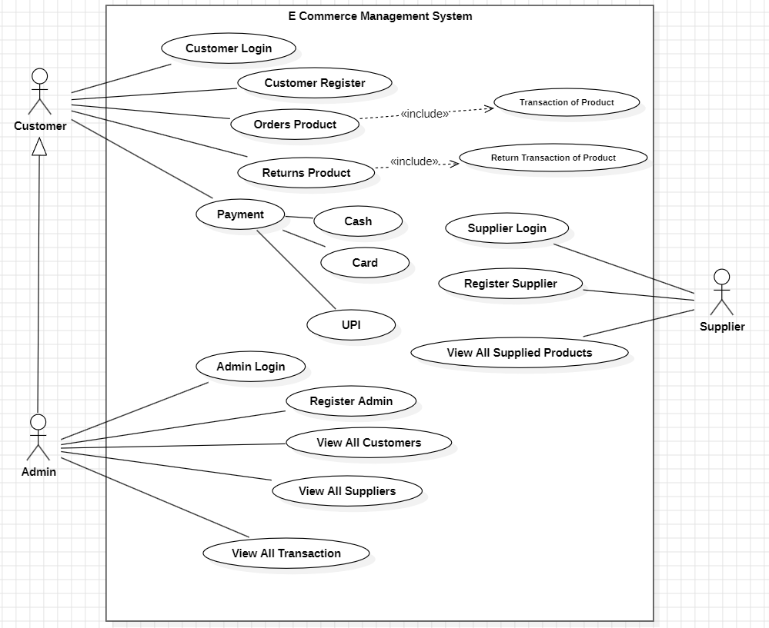
Use Case Diagram

Slide 5

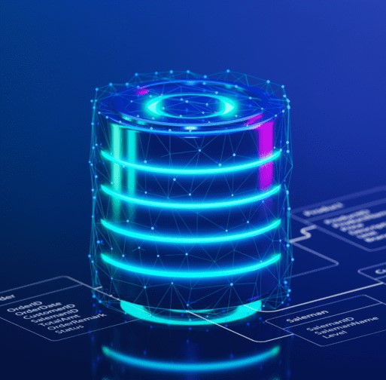
Database Management Concepts
1
Data Modeling
Designing an effective data model is crucial for storing and managing admin, customer, supplier, product, and transaction information.
2
SQL Queries
Proficiency in SQL allows developers to efficiently retrieve, manipulate, and analyze data within the ecommerce system.
3
Procedures & Triggers
Efficient procedures and triggers to control over tables to insert, update and remove records.

Slide 6

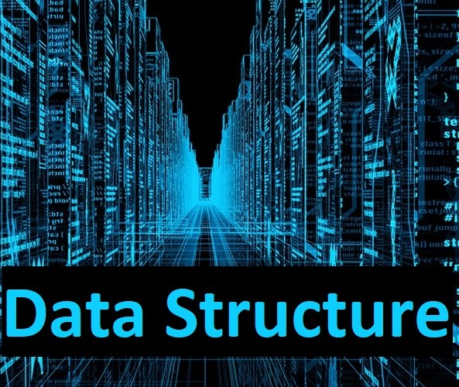
Data Structures and Algorithms
1
Linked Lists
2
Stack
Effectively Managing products and shopping carts using linked lists.
Effectively managing search history of user searched product using stacks.

Slide 7







Java Concepts
Microservices & OOPs Concepts
Adopting a microservices-based architecture to improve scalability and flexibility.
There are oops concepts like Classes and objects, polymorphism, inheritance, packages,
access modifiers, encapsulation, constructors and etc.
JDBC - Java Database Connectivity
To interact with database and Insert, Update, Remove and also Fetch and Create data.
Constructors & Methods
Effectively used constructor and methods to interact with database and also interact with customer, admin and supplier entities
Java Swing
A small part of Java Swing API to generate OTPs as a popup window
File Handling
Using Java IO Programming generating and saving bills for purchased product and returned product

Slide 8

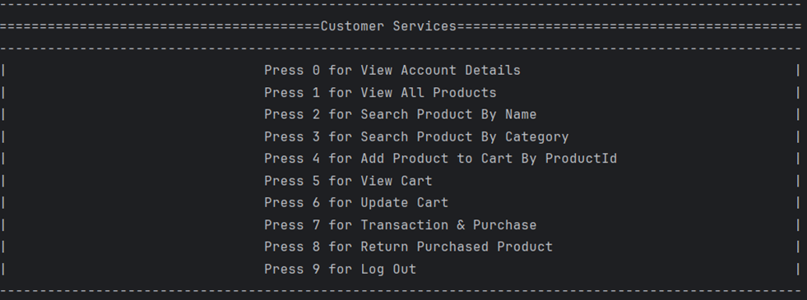





Customer Interface and Experience
Intuitive Search
Cart Operations
Bill Generation
Customer can search product by Name and Category of Product also can see whole Product List
By using Product Id of a Product and purchasing quantity, customer can add, update, remove products from cart.
When customer ready to buy cart items, a bill is generated for him.
Transaction
Product Return
Facility to transact in various ways via Cash or Card or UPI.
A product return facility for customer to return the purchased product once

Slide 9

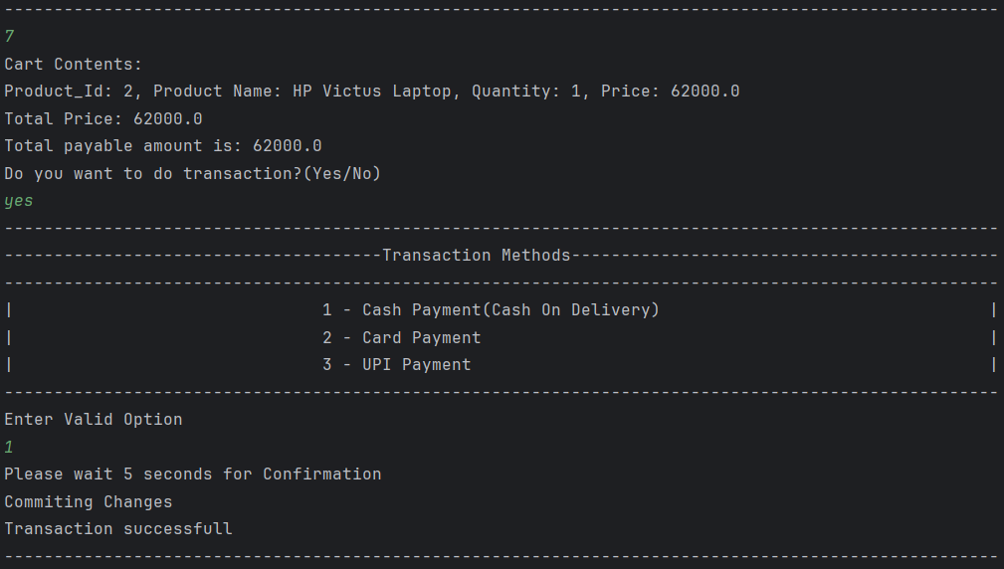
Order Processing and Inventory Management
Order Placement
When a order is placed there an update occurs in Database
Inventory Tracking
Real-time monitoring of product availability and stock levels.
Fulfillment Workflow
Streamlined fulfillment of orders, return orders and transaction processes.
Returns and Transaction
Seamless handling of product returns and return transaction.

Slide 10



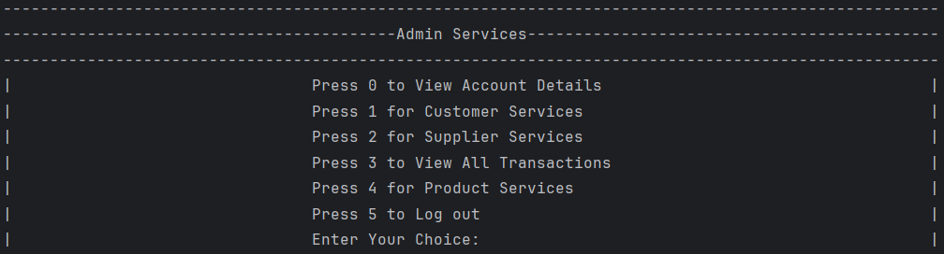

Admin Interface
Browsing Database
Insert Facility
Admin can browse through customers, suppliers, transactions, orders and return orders.
Admin has a facility to add customers, suppliers and products.
Update Facility
Admin has a facility to update products.

Slide 11
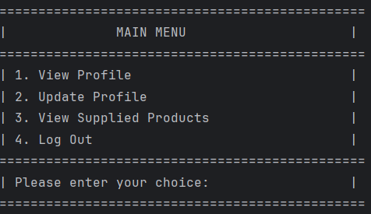
Supplier Interface
View Profile
Update Profile
Suppliers can view their profile within full of their details
Suppliers can update their profile such as name, email id, password, and etc.
Supplied Product
Suppliers can access the product list of their supplied products

Slide 12

Merits of the Project
1
Intuitive Customer Interface
2
Efficient Order Processing
Allows customers to easily search, add to cart, and purchase products.
Streamlined fulfillment of orders, returns, and transactions.
3
Comprehensive Admin Features
4
Supplier Collaboration
Enables admin to manage customers, suppliers, and products effectively.
Gives suppliers visibility over their product listings.

Slide 13

Demerits of the Project
Complexity
Dependency on Technology
Complex setup and maintenance for small businesses
Vulnerable to outages, hacking, and issues
Cost
It is too costly to implement the whole system.

Slide 14

Future Enhancements
Artificial Intelligence
Omnichannel Integration
Incorporating AI-powered features like chatbots and predictive analytics to enhance the customer experience.
Seamlessly integrating the ecommerce platform with brick-and-mortar stores and other sales channels.
Blockchain Technology
Sustainability Initiatives
Exploring the integration of blockchain for secure transactions and transparent supply chain management.
Implementing eco-friendly practices and features to align with customer preferences for sustainable ecommerce.

Slide 15
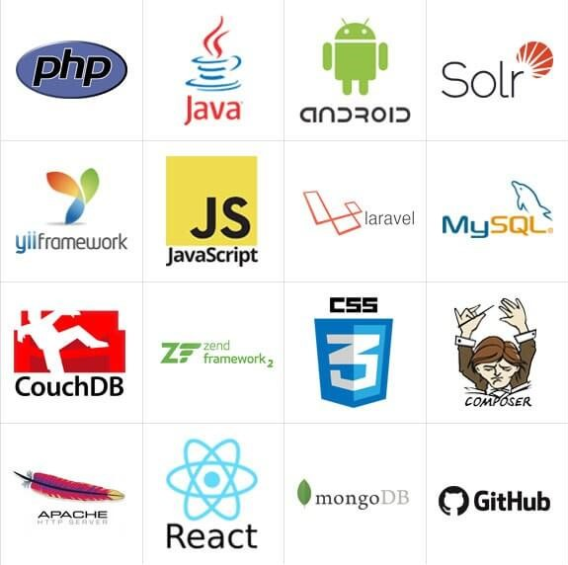



Tools Used in Our Project
Java
MySQL
IntelliJ IDEA
Primary programming language to create and manage application.
Relational database management system to handle database operations.
Integrated development environment is software where whole logic of the application is written

Slide 16

Thank you
Please let me know if you have any other questions?

